Slide 1
SOCIAL NETWORK SEARCH
Michael Huben -15396501
Josh Malone - 15357971
Matthew Farrelly - 15366246
Maksims Kompanijecs - 15309671

Slide 2

GoSocial
GoSocial
Universal search engine across multiple social media platforms (Facebook, Instagram, Twitter, Reddit)
Users given an option on to search for:
Images, text
blogs, articles
trends, hashtags
GoSocial scans social media networks based on the search query
Returns results based on most relevant, popular and up-to-date results

Slide 3
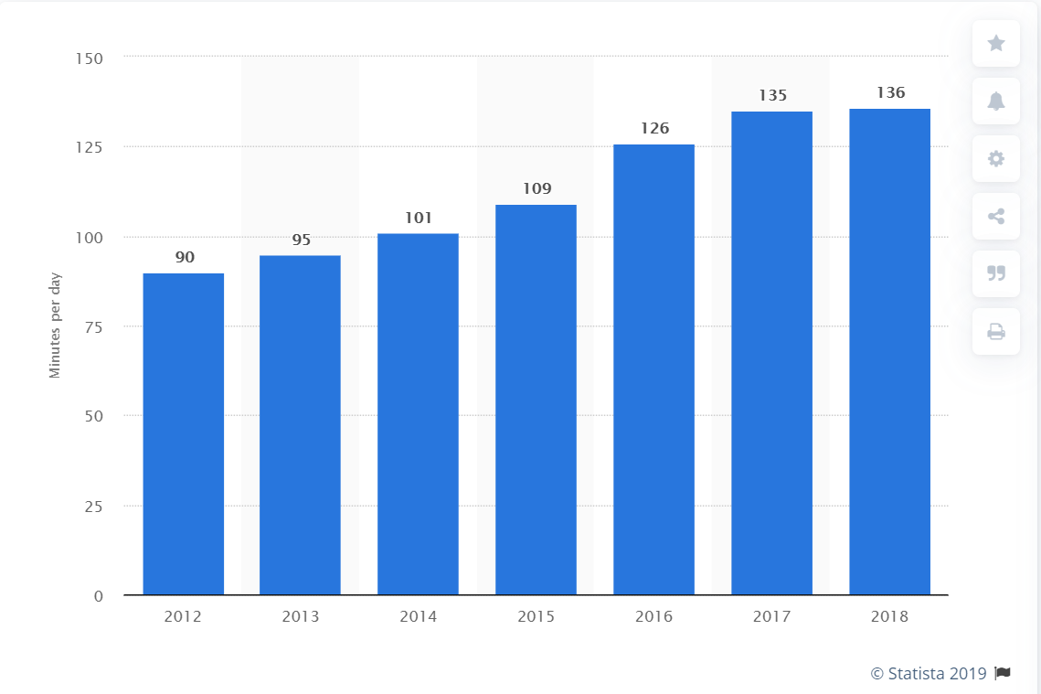
Users & Motivation
Users spend a lot of time browsing multiple different social media platforms
Most of the content is the same - news, current events, sports, memes
A universal platform will save users time and allow them to consume relevant content more efficiently
E.g. A user interested in a general election can search and find the most popular/relevant articles, posts & media relating to it
Average amount spent on social media in the recent years
Notes:
https://www.statista.com/statistics/433871/daily-social-media-usage-worldwide/

Slide 4
User Analysis
User demographic will be of ages 18 - 29 as they are the most active social media users
Expected user knowledge:
Non-specialised with no experience in search technologies
Proficient in general search & social media usage
Expected type of search queries:
Informational queries
Multimedia search
Notes:
https://www.wordstream.com/blog/ws/2012/12/10/three-types-of-search-queries
https://loop.dcu.ie/pluginfile.php/2865826/mod_resource/content/8/mmsearch.pdf

Slide 5
Problems with Social Media Content
Content variety and style - information on social media has different format, length, quality, language
Poor quality content - content with typos, poor choice of words
Misinformation - deliberate spam, to attract attention
Duplicate content - very similar or duplicate information published on the same site
Inaccessible content - private, not accessible content

Slide 6
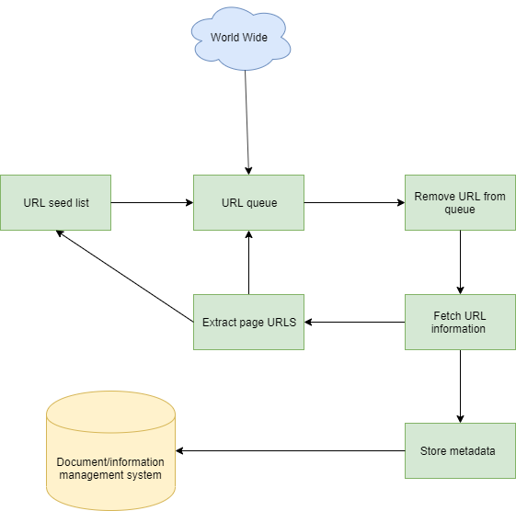
Functional Description - Web Crawler
Navigate through the web and collect HTML page data/information on multiple social media platforms
It is important for web crawler to follow a policy to:
How to know what pages are relevant
To know when to check back again the same pages
Be more sensitive about what pages it should crawl and in what order
And respect robots.txt file
Don’t degrade website performance
An identify website being crawled with contact information
Notes:
https://www.wordstream.com/blog/ws/2012/12/10/three-types-of-search-queries
https://loop.dcu.ie/pluginfile.php/2865826/mod_resource/content/8/mmsearch.pdf

Slide 7
Functional Description - Document Indexing
Efficient information retrieval will be achieved by document indexing
This feature allows search engines to access the data easily that it requires
We will index documents by:
Stopwords needs to be removed such as ‘and’,’in’ etc
Break up sentences/strings/text into tokens - tokenization
Transformation of words to their root form - stemming
Normalization - transformation of text into its simplest form
Notes:
https://www.wordstream.com/blog/ws/2012/12/10/three-types-of-search-queries
https://loop.dcu.ie/pluginfile.php/2865826/mod_resource/content/8/mmsearch.pdf

Slide 8
Functional Description - Ranking
Last component of our system will be the ordering of search results by most relevant to least relevant based on the search query
We will most likely opt in to implement PageRank algorithm
It’s more feasible as it computes rank score during indexing rather then query time
Returns relevant content as the rank is calculated based on popularity of the page
Notes:
https://www.wordstream.com/blog/ws/2012/12/10/three-types-of-search-queries
https://loop.dcu.ie/pluginfile.php/2865826/mod_resource/content/8/mmsearch.pdf

Slide 9
Evaluation
To accurately evaluate our technology, we must calculate both precision & recall values
To fine-tune our search technology at the beginning of its life-cycle, we intend on implementing test collections
These collections will begin with standard ‘b’ and ‘k’ values
The product is heavily user-focused, so their values and preferences will be taken into account often

Slide 10
Conclusion
Search Technology USP:
Universal one-stop social media browser
Ability to search popular social media artifacts (text, multimedia, hashtags)
Target demographic:
Active social media users
No specialised skill-set or queries
General social media & search proficiency
GoSocial Function:
Web crawler that parses the data from social media sites
Documents indexed & ranked
Results displayed to end user

Slide 11
Any Questions?
GoSocial

